Slide 1
Lecture 12
Scalability and Gas Economy

Slide 2
Transaction Markets
Miner → Maximum Extractable Value
Notes:
3sta2DnUwM^yjVzZsy^*RZ5Hid

Slide 3
Bonus Point
If Google is a browser but is selling ads, what is Ethereum selling? What is the internal currency?
Notes:
3sta2DnUwM^yjVzZsy^*RZ5Hid

Slide 4
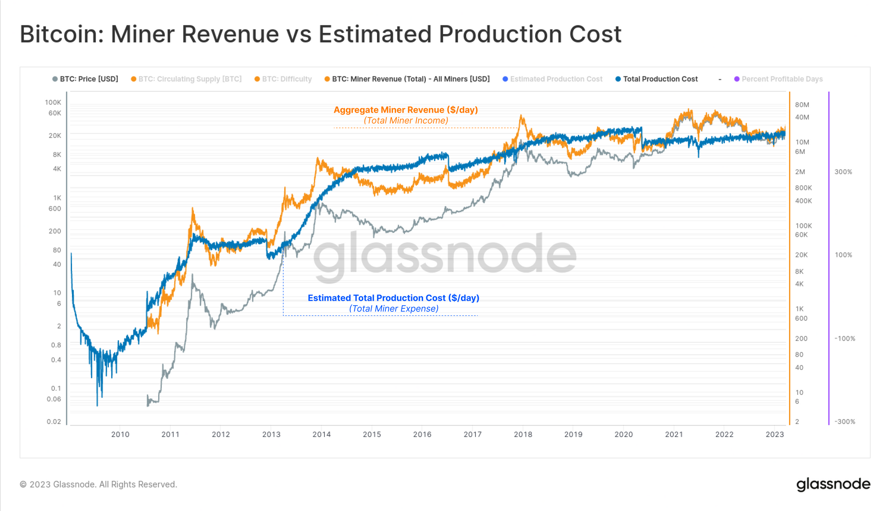

Slide 5
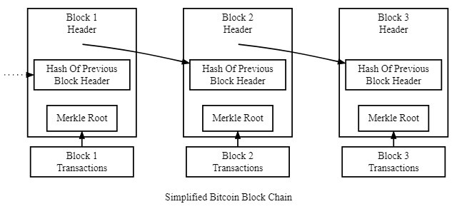
Miner to Maximizer
Last Bitcoin Halving: 22 April 2024
6.25 to 3.125 Bitcoin per validated block.

Slide 6




Mempool/Txpool - Transaction lifecycle V1
Does this exceed block gas limit?
Call func x at contract address 0xblahblah
The maximum (gas limit) I am willing to pay is y.
Refund unused gas
The max (gas limit) I am willing to pay
A payload of Bytecode.
A stream of incoming transactions
EVM

Slide 7
PoW - First price auction market
Fixed supply, iterable, blind auctions
If I don't get included in this block, I try to get into the next block
Every block is capped at 15Mil gas computation power
Don't know what others are setting their max gas limits to
Users pay for computing power!

Slide 8
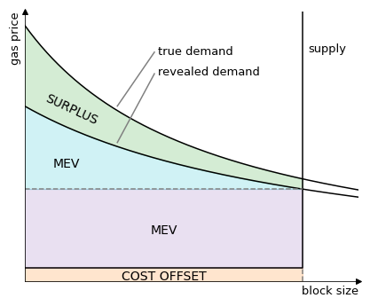
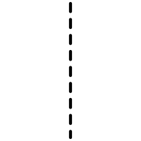
Perfectly discriminated, completely full blocks
What if I really want to get in but have no money? What if my txn is extremely large?
Market clearance price
https://hackmd.io/@adietrichs/eip-1559

Slide 9
EIP 1559 - Towards diversification and deflation
Bitcoin has a supply cap of 21Mil and is halving miner rewards
Ethereum has UNLIMITED supply. How to control?
All MEV going towards miners. Users are maximally exploited.
Miner monopoly on txn order leads to shady collusion. Giving more value to miners.
Goal: reduce mining incentive and transfer to other forms of value
Move to a uniform price auction model
There are n amount of products and the top n bidders pay the first rejected bid (aka. everyone pays market clearing price)

Slide 10
Gas fee calculation - EIP 1559
This fee is paid regardless of outcome - success or fail
units of gas used * (base fee + priority fee)
Based on transaction complexity
Deploying a contract is very expensive!
A "tip" for the validator.
Remember zero bids on Black Thursday?
This fee is retained by validator
Mining pools usually set a minimum (2 gwei)
Wallets allow different settings. Or set your own through RPC.
Minimum amount required for txn to be considered valid. Affected by the queue length in mempools of many nodes.
Long queues = high txn volume = higher fees
This fee is burned upon successful incorporation into a block

Slide 11
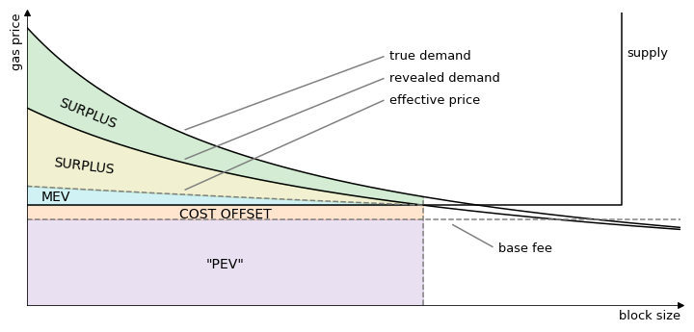
Perfect (user) competition, half filled blocks
30Mil gas limit
15Mil block target balances out long and short term goals
15Mil gas target
Can tolerate high transaction volume but not forever

Slide 12

Base fee calculation - Tâtonnement
If you can read French - https://www.jstor.org/stable/44346456
A control method to estimate market clearing price based on revealed demand.
  Block higher than 15Mil will increase base price and decrease txns
  Block lower than 15Mil will decrease base price and increase txn submission
  How to prevent miners mining zero blocks?
The bigger the k, the smaller the change. Current k = 8.

Slide 13
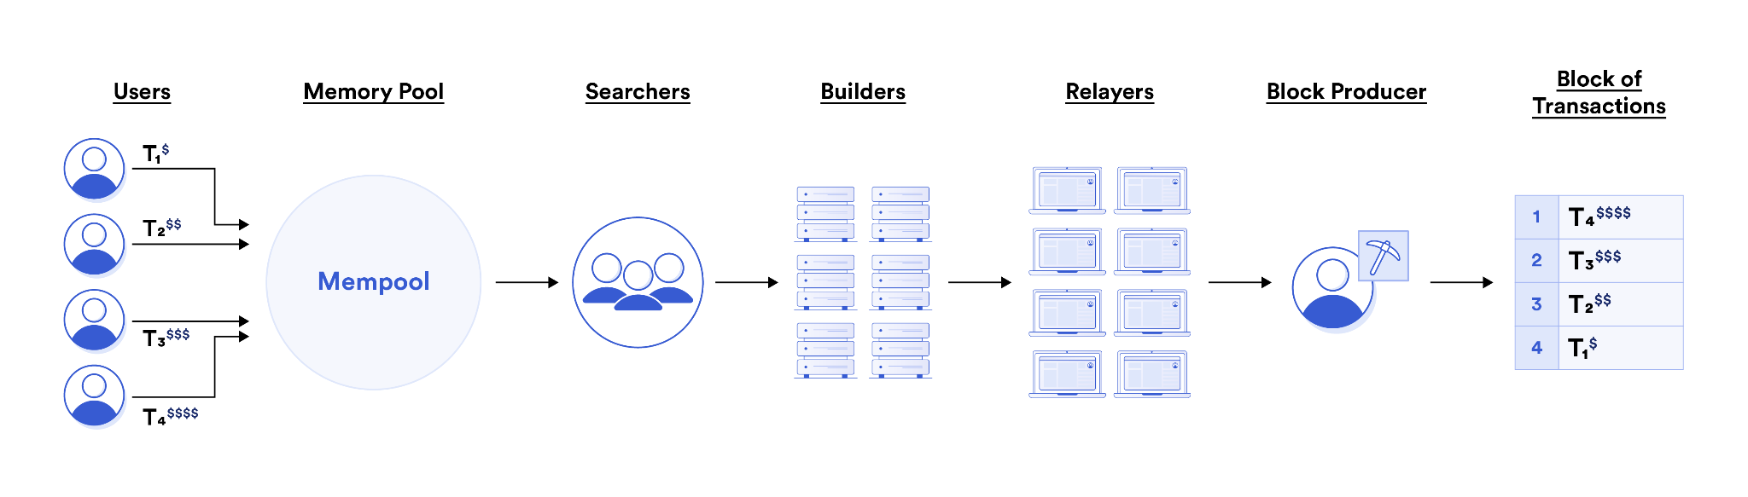
MEV Value Chain - All is fair in love and MEV
1 month after The Merge, only ~23% Miners remained
MEV Boost Config
Searches for transactions in many mempools and create bundles of profitable txns through simulating txn ordering
Builders aggregate these bundles into a full block.
Direct competitor to public mempools.
Relayers aggregate builders and send most valuable blocks to validators - who are also running mev-boost (transaction marketplace)
90% of blocks today are MEV bot mined.

Slide 14
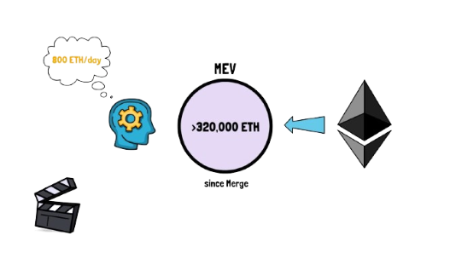
The current state of MEV
The Good
The Bad - centralization
Builder centralization - currently 80% of blocks created by 5 groups
Relay centralization - 7 relays controlling 90%
Validator reordering - validators take turns, block reordering profitable
Toxic forms of MEV - Sandwich Attacks
More efficient DeFi markets, higher returns for arbitrageurs
New financial products - MEV blocker, permissioned mempools

Slide 15
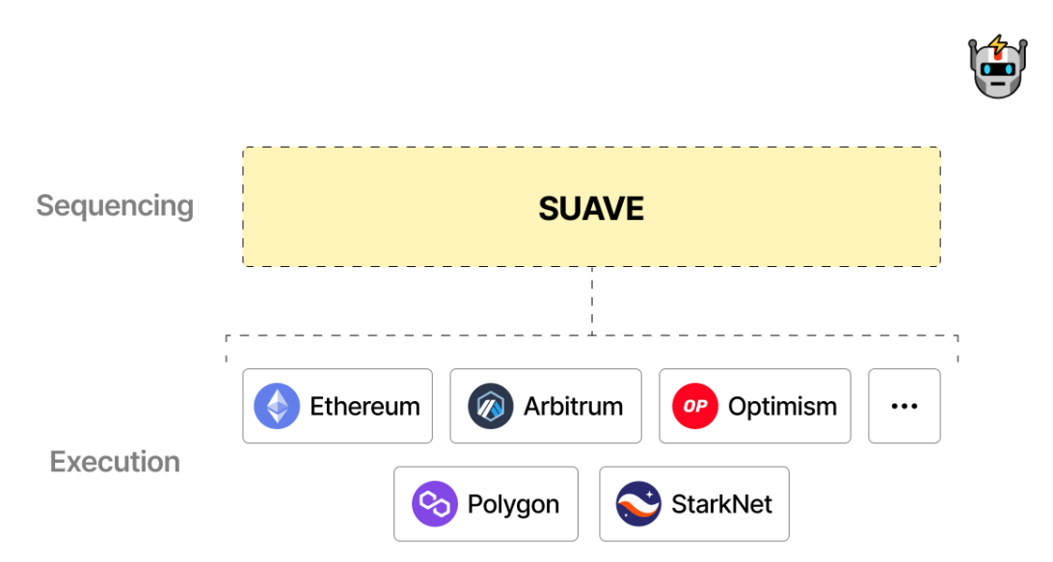
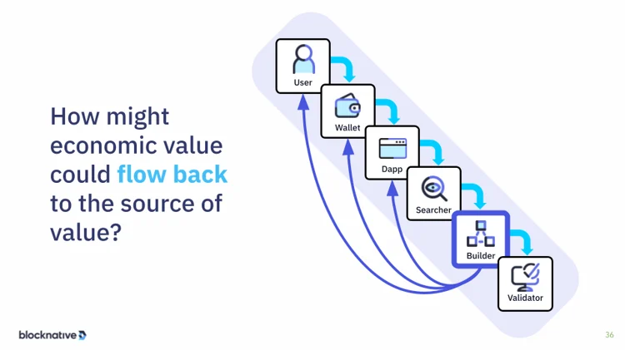
The future of MEV (of Blockchain?)
MEV Burning vs Smoothing
The chain takes control of the MEV and burn it like the base price.
Mechanism for distributing MEV amongst validators
MEV tax (half burn?)
Once again towards decentralization….
Multi-chain mempool democratization
MEV Sharing

Slide 16
Layer 2 Scaling
State Channels, Side Chains, Rollups

Slide 17
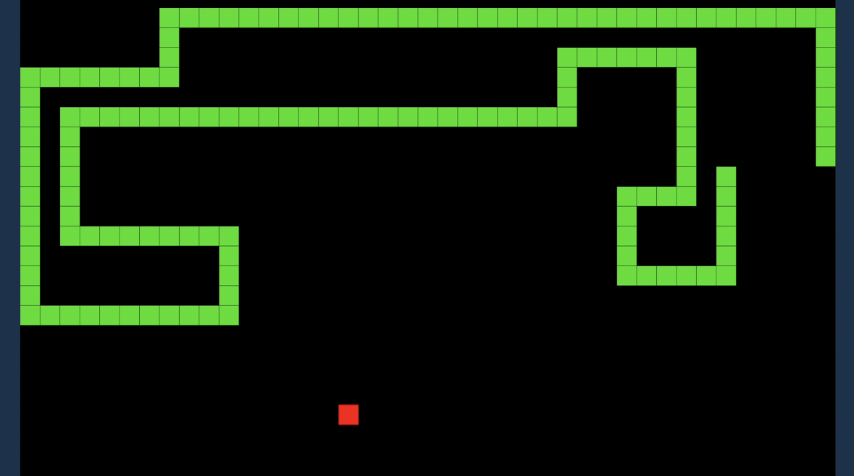
State Channels - Moving transactions off chain
Only 2 transactions: channel open state and channel close state

Slide 18



State Channels - multisig smart contracts
Deposit some ETH into the contract - initial capital
Opens the channel by creating multisig contract
Every transaction requires both signatures (or quorum)
Instantaneous
Fee-less
In the good case, everyone finishes transacting and closes the contract, getting their remaining balance back. Contract sends final state to the blockchain.
In the bad case, one person can call a contract kill option. Last transaction with all signatures is final state. There is a challenge period before resolution.

Slide 19
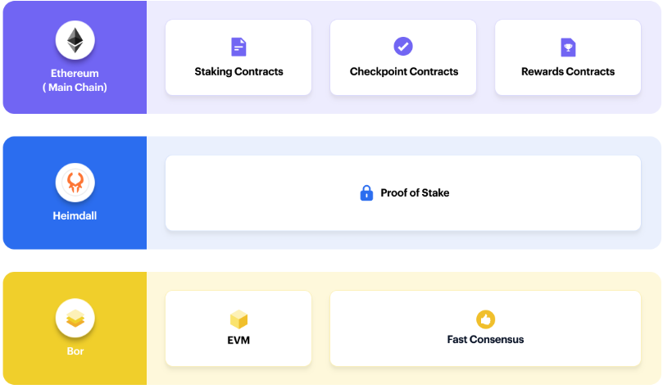
Side Chain Example - Polygon Matic

Slide 20
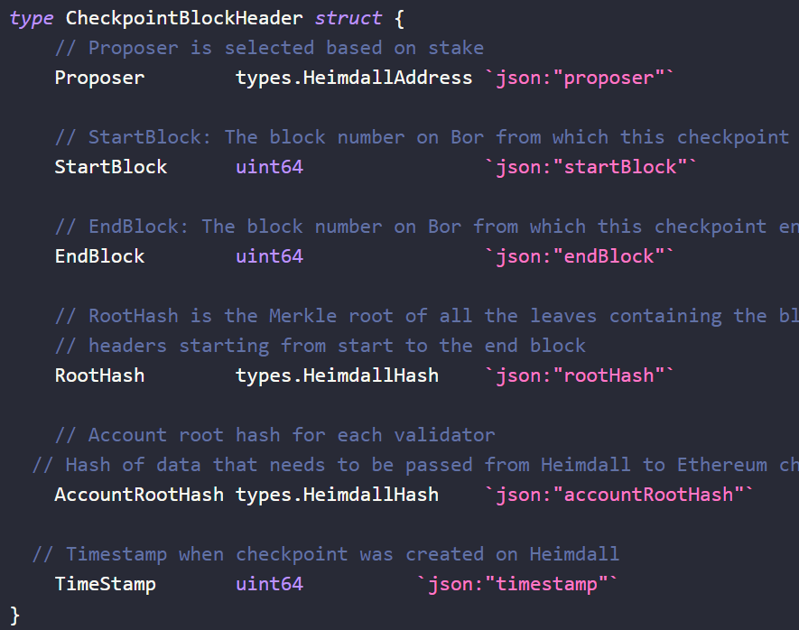
Heimdall Checkpoints
Heimdall Nodes must produce checkpoints which conform to the struct shown in code.
The RootHash hashes all blocks from start to end.
Validator group must vote on the validity of this checkpoint before it is submitted to the Checkpoint contract on Ethereum.

Slide 21

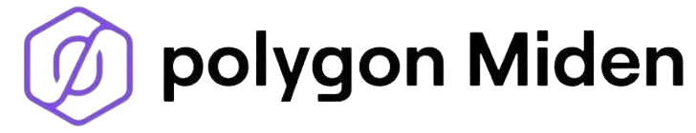
Rollups - best of both world
State Channels are only useful for limited use cases.
Side Chains sacrifice security for speed
Rollup Receipt Contract
Operator
Sequencer
TX3
Only post TX data as calldata
TX 2
Rollup Protocol Contract
Store new state of L2 chain
TX 1
Smart Contract
Trusted Bridge
Trustless Bridge built into smart contract
Smart Contract

Slide 22
Rollups - Optimistic vs Zero Knowledge
Optimistic - Fraud Proof
ZK- Validity Proof
TXs
ZK SNARK
ZK STARK
Rollup Receipt Contract
Operator
Sequencer
Verifier
Operator
Sequencer
Rollup Protocol Contract
Rollup Protocol Contract
Batch root
Rollups are posted as assertion blocks. There is a challenge window per assertion. If challenged, all transactions in rollup gets executed on the Ethereum chain. This can get expensive! If fraudulent, the operator gets slashed.
Challenge Assertion
In this setup, no challenges are necessary!

Slide 23
Zero Knowledge Proofs

Slide 24









ZK Proof - Mathematical Example
Verifier
Prove x
Prover

Slide 25
Bonus Point
In the context of L2s, what is x?
Notes:
3sta2DnUwM^yjVzZsy^*RZ5Hid

Slide 26
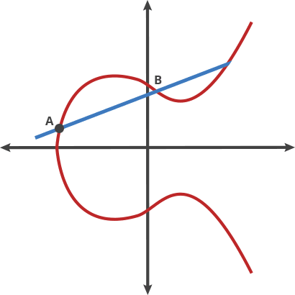
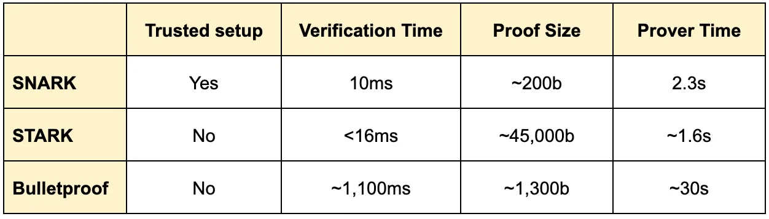
ZK Proof System Construction Comparison
SNARK - Succinct Non-interactive Argument of Knowledge
  Succinct because verification is much faster than proof generation
  Requires a trusted setup environment - longer proving times
  Generated from an elliptic curve - fast and secure
STARK - Scalable Transparent Argument of Knowledge
  Extremely complex hashes making proofs very big
  Can be verified publically by anyone - scalable and transparent!
Bulletproof
  Tries to get the best of both worlds - small proof size and no setup
  Unfortunately extremely long proving and verification times
D
c
Setups are a potential attack vector. Require the correct hardware and configuration.
Larger proofs are more network intensive.
Time needed to generate proof and verify affect throughput.

Slide 27
Where to next?

